Slide 1
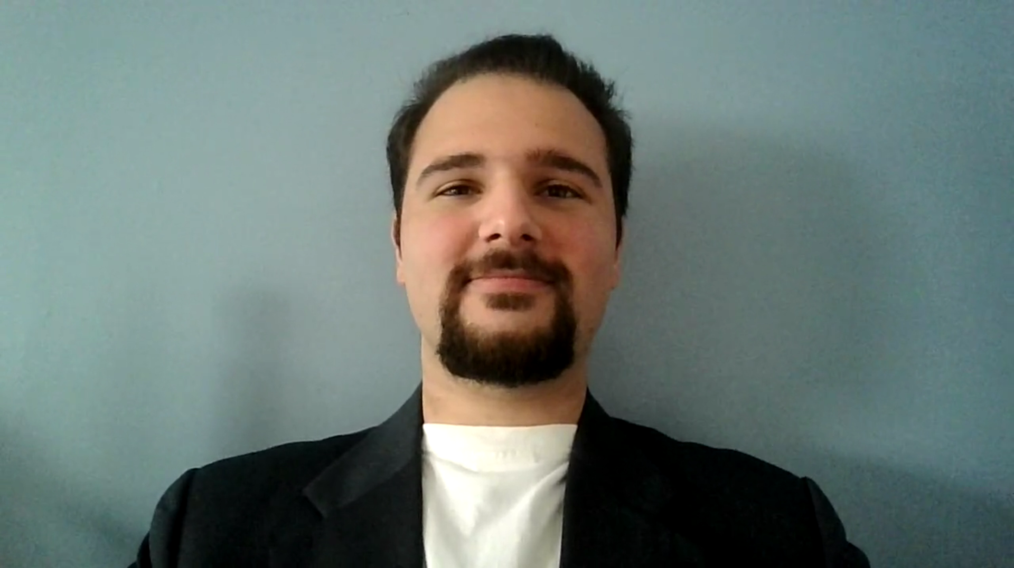
Farhan Irani 100748418
INFR 3335U – Social And Multiplayer Game Design Tom Tsiliopoulos Final Exam Due date Saturday December 18, 2021 @ Midnight

